Slide 1


Strings and Text Processing
Processing and Manipulating Text
SoftUni Team
Technical Trainers
Software University
http://softuni.bg

Slide 2



Table of Contents
What is a String?
Manipulating Strings
Comparing, Concatenating, Searching
Extracting Substrings, Splitting
Building and Modifying Strings
Operator +

Slide 3
Questions
sli.do #python-fund

Slide 4

Strings

Slide 5
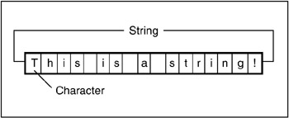
What is a String?
String objects contain an immutable (read-only) sequence of characters
Before initializing, a string variable has '' value

Slide 6
Manipulating Strings
Comparing, Concatenating, Searching, Extracting Substrings, Splitting

Slide 7
Comparing Strings
There are several ways to compare two strings
Case-sensitive:
Comparing with > and < checks the strings’ lexicographic order
Case-insensitive:
str1 < str2
str1 > str2
str1 == str2
str1 <= str2
str1.lower() < str2.lower()
str1.lower() > str2.lower()
str1.lower() == str2.lower()
str1.lower() <= str2.lower()
'alice' < 'bobby' # True (a (97) < b (98))
'alice' < 'ali' # False (second string is shorter)

Slide 8
Concatenating Strings
There are several ways to concatenate strings:
Using the join() method
Using the + or the += operators
Any object can be appended to a string using str():
str = ' '.join('hi', 'gosho') # hi gosho
result = str1 + str2 + str3
result += str1
name = "Peter"
age = 22
s = name + " " + str(age) # → "Peter 22"

Slide 9

Searching in Strings
Finding a character or substring within given string
str.find(term) – returns the index of the first occurrence
Returns -1 if there is no match
str.rfind(term) – returns the index of the last occurrence
str.find(term) and str.index(term) work identically except index() throws ValueError if the string is not found
email = "vasko@gmail.org"
first_index = email.find("@") # 5
no_index = email.find("/") # -1
verse = "To be or not to be.."
lastIndex = verse.rfind("be") # 16

Slide 10
Problem: Count Substring Occurrences
You are given a text and a pattern
Find how many times that pattern is in the text.
Overlapping is allowed
ababa caba
aba
3
aaaaaa
aa
5
Welcome to SoftUni
Java
0
Check your solution here: https://judge.softuni.bg/Contests/952/

Slide 11
Solution: Count Substring occurrences
text, lookup_text = input(), input()
occurrences, current_index = 0, 0
while current_index != -1:
current_index = text.find(lookup_text, current_index)
if current_index is not -1:
occurrences += 1
current_index += 1
print(occurrences)
starting index

Slide 12
Extracting Substrings
Getting substrings from a string, using list slicing:
str[startIndex:startIndex + length]
str[startIndex:]
filename = r"C:\Pics\Rila2005.jpg"
name = filename[8:16] # Rila2005
filename = "C:\\Pics\\Summer2009.jpg"
name_аnd_extension = filename[8:]
# name_and_extension is Summer2009.jpg
0 | 1 | 2 | 3 | 4 | 5 | 6 | 7 | 8 | 9 | 10 | 11 | 12 | 13 | 14 | 15 | 16 | 17 | 18 | 19
C | : | \ | P | i | c | s | \ | R | i | l | a | 2 | 0 | 0 | 5 | . | j | p | g

Slide 13

Splitting Strings
To split a string by given separator use the split() method
listOfBeers = "Amstel, Zagorka, Tuborg, Becks"
beers = listOfBeers.split(',')
print("Available beers are:")
for beer in beers:
print(beer)

Slide 14
Other String Operations
Replacing, Deleting Substrings, Changing Case

Slide 15
Replacing and Deleting Substrings
str.replace(match, term) – replaces all occurrences of given string with another (resulting in a new string)
Deleting (or replacing) part of a string (with list slicing):
cocktail = "Vodka + Martini + Cherry";
replaced = cocktail.replace("+", "and");
# Vodka and Martini and Cherry
some_str = 'hello(this text should be removed) there!'
some_str = some_str[:5] + some_str[-7:]
print(some_str) # hello there!

Slide 16
Problem: Text filter
You are given a text and a string of banned words
Replace all banned words in the text.
You should replace with "*", equal to the word's length
Linux, Windows
It is not Linux, it is GNU/Linux. Linux is merely the kernel, while GNU adds the functionality...
It is not *****, it is GNU/*****. ***** is merely the kernel, while GNU adds the functionality...
Check your solution here: https://judge.softuni.bg/Contests/952/

Slide 17
Solution: Text Filter
Using str.replace() to filter text:
banned_words = input().split(', ')
text = input()
for word in banned_words:
text = text.replace(word, '*' * len(word))
print(text)

Slide 18
Changing Character Casing
Using the various case changing methods:
text = "on GREEN Dolphin Straße"
lowercase = text.lower() # on green dolphin straße
uppercase = text.upper() # ON GREEN DOLPHIN STRASSE
titlecase = text.title() # On Green Dolphin Straße
capital = text.capitalize() # On green dolphin straße
casefold = text.casefold() # on green dolphin strasse
caseswap = text.swapcase() # ON green dOLPHIN sTRASSE

Slide 19
Trimming White Space
str.strip() – trims whitespaces at start and end of string
str.strip(chars)
str.lstrip() and str.rstrip()
s = " example of white space "
clean = s.strip()
print(clean) # "example of white space"
s = " \t\nHello!!! \n"
clean = s.strip(' ', ',' ,'!', '\n', '\t')
print(clean) # "Hello"
s = " C# "
clean = s.lstrip() # "C# "

Slide 20

String Operations
Exercises in class

Slide 21
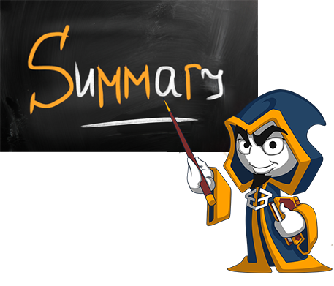
Summary
Strings are immutable sequences of characters
Changes to the string creates a new object, instead of modifying the old one
Comparing strings using ==, <, > operators
Replacing, deleting substrings
Case methods

Slide 23






SoftUni Diamond Partners

Slide 24






SoftUni Diamond Partners

Slide 25

License
This course (slides, examples, demos, videos, homework, etc.) is licensed under the "Creative Commons Attribution-NonCommercial-ShareAlike 4.0 International" license

Slide 26
Trainings @ Software University (SoftUni)
Software University – High-Quality Education, Profession and Job for Software Developers
softuni.bg
Software University Foundation
http://softuni.foundation/
Software University @ Facebook
facebook.com/SoftwareUniversity
Software University Forums
forum.softuni.bg

